Slide 1
Introduction to Recurrent Neural Network
Bokan Bao
Professor Dasgupta
CSE 254
Notes:
Recurrent neural network is a very important structure

Slide 2
Outlines
RNN introduction
Limitation of Vanilla Neural Network
Structure of the RNN
PyTorch implementation
Character-Level prediction
Unsmoothed Maximum Likelihood Character Level Language Model
Three-layer RNN
Notes:
Unsmoothed Maximum Likelihood Character Level Language Model
https://nbviewer.jupyter.org/gist/yoavg/d76121dfde2618422139
Character-Level Language Models
https://karpathy.github.io/2015/05/21/rnn-effectiveness/
Generating Sequences with RNN
https://arxiv.org/pdf/1308.0850.pdf

Slide 3
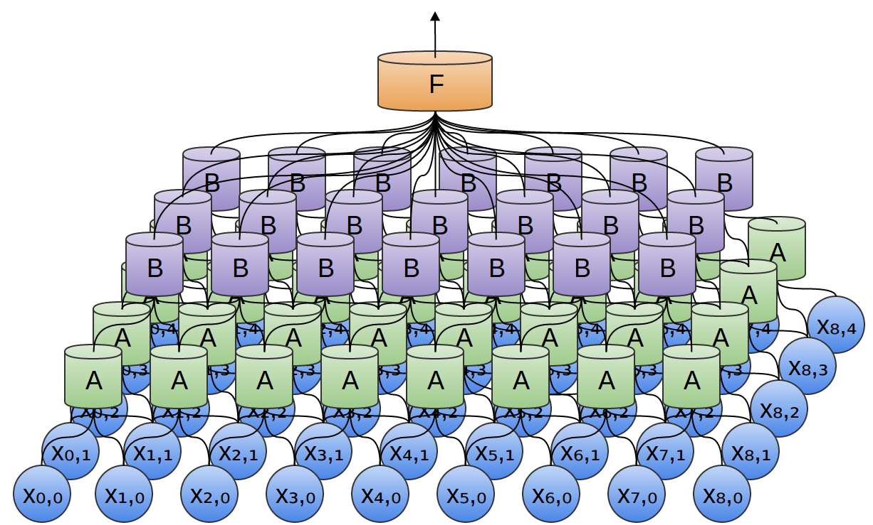

Vanilla Neural Network
They accept a fixed-sized vector as input (e.g. an image) and produce a fixed-sized vector as output (e.g. probabilities of different classes).
Notes:
they accept a fixed-sized vector as input (e.g. an image) and produce a fixed-sized vector as output (e.g. probabilities of different classes). Not only that: These models perform this mapping using a fixed amount of computational steps (e.g. the number of layers in the model). The core reason that recurrent nets are more exciting is that they allow us to operate over sequences of vectors: Sequences in the input, the output, or in the most general case both. A few examples may make this more concrete:

Slide 4

Recurrent Neural Network

Slide 5

Recurrent Neural Network
Flexible, a sequence of the data
Music, text, motion capture
The predictive distribution depends on the previous inputs.

Slide 6
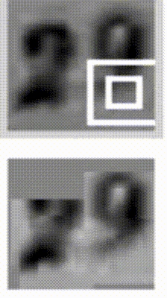
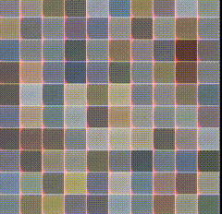
A sequence of many things

Slide 7
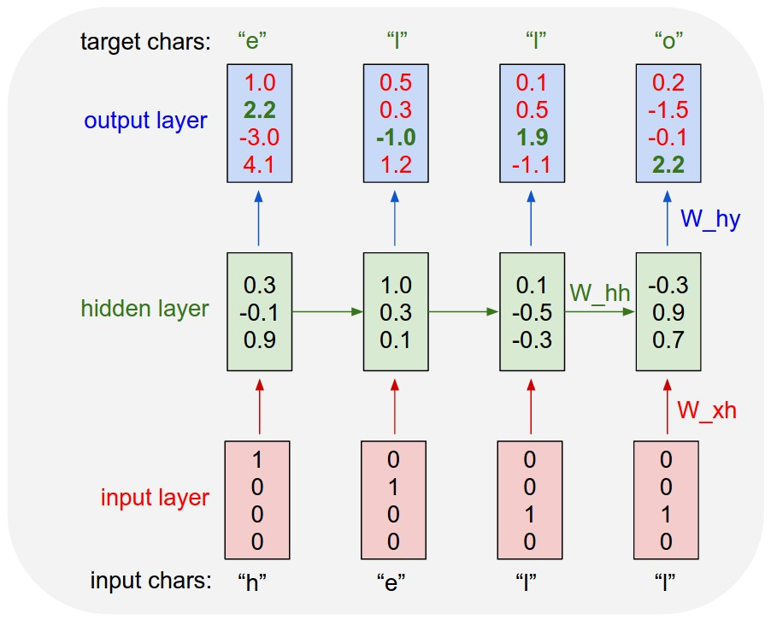
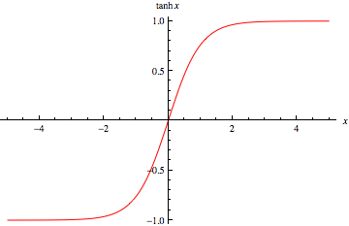
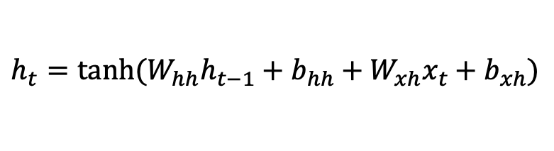
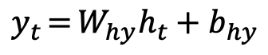
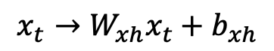
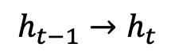
Simple RNN model
$$x_{t}→W_{xh}x_{t}+b_{xh}$$
$$h_{t−1}→h_{t}$$
$$h_{t}=tanh⁡(W_{hh}h_{t−1}+b_{hh}+W_{xh}x_{t}+b_{xh})$$
$$y_{t}={W_{hy}h_{t}}+b_{hy}$$
Notes:
The building blocks of

Slide 8
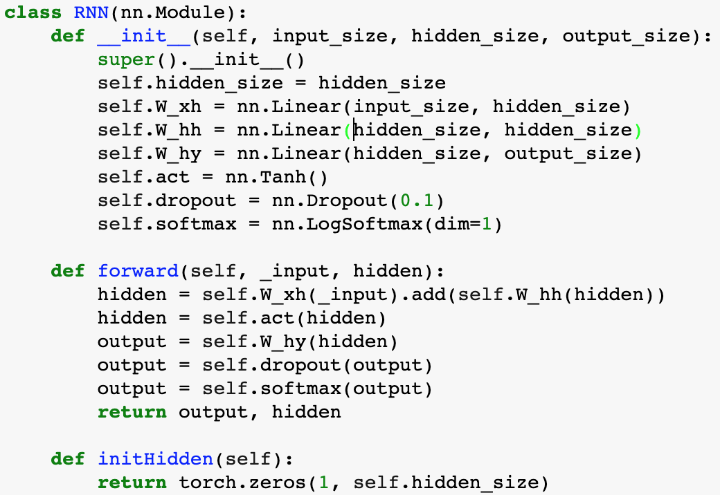
Pytorch implementation

Slide 9
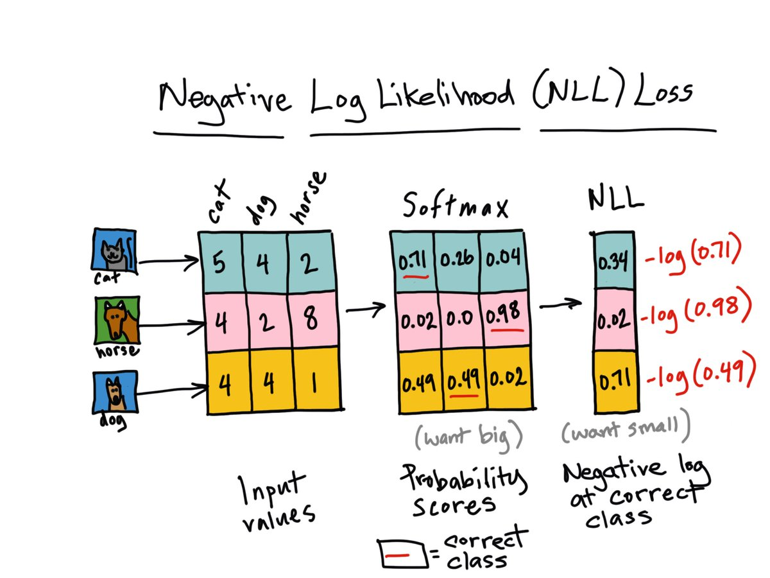
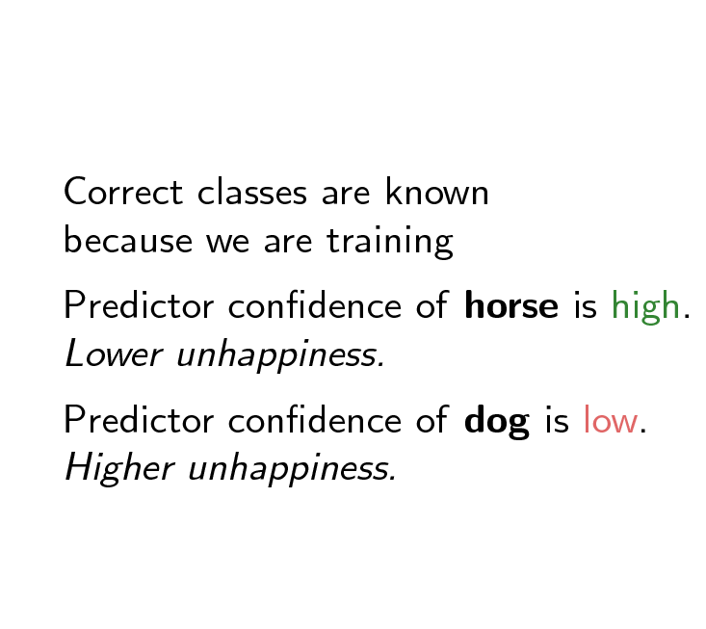
Loss function: Negative Log Likelihood Loss

Slide 10
Optimization function: Adam
Adam was presented by Diederik Kingma from OpenAI and Jimmy Ba from the University of Toronto in their 2015 ICLR paper (poster) titled “Adam: A Method for Stochastic Optimization“. I will quote liberally from their paper in this post, unless stated otherwise.
The authors describe Adam as combining the advantages of two other extensions of stochastic gradient descent. Specifically:
Adaptive Gradient Algorithm (AdaGrad)
Root Mean Square Propagation (RMSProp)

Slide 11
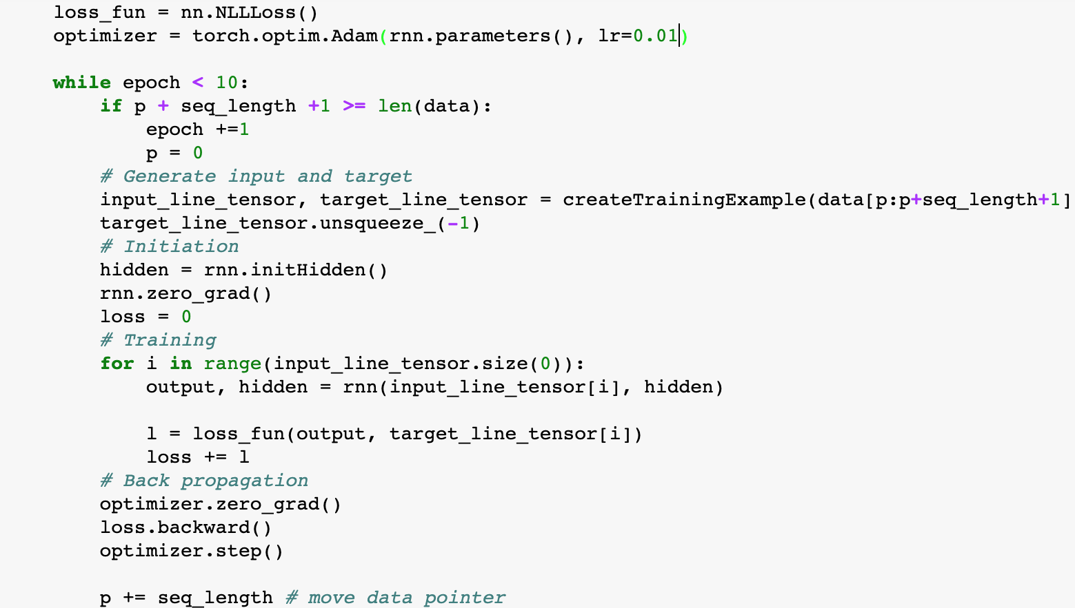
Training

Slide 12
Outlines
RNN introduction
Limitation of Vanilla Neural Network
Structure of the RNN
PyTorch implementation
Character-Level prediction
Unsmoothed Maximum Likelihood Character Level Language Model
Three-layer RNN
Notes:
Unsmoothed Maximum Likelihood Character Level Language Model
https://nbviewer.jupyter.org/gist/yoavg/d76121dfde2618422139
Character-Level Language Models
https://karpathy.github.io/2015/05/21/rnn-effectiveness/
Generating Sequences with RNN
https://arxiv.org/pdf/1308.0850.pdf

Slide 13
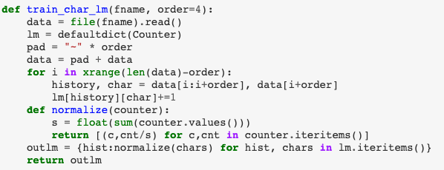
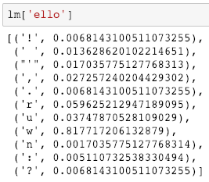
Character-Level Predict Model
Unsmoothed Maximum Likelihood Model
c is character, h is a n letters history
P(c|h) stands for how likely is it to see c after we've seen h.
Training data: Shakespeare
demo: A 4-letter model
Deterministic model
High dimensions
Notes:
and P(c|h)P(c|h) stands for how likely is it to see cc after we've seen hh.
If there is no data point the probability will be 0
Even the result might be different, the probabilistic distribution is exactly same.
Assuming the predictions are probabilistic, novel sequences can be generated from a trained network by iteratively sampling from the network’s output distribution, then feeding in the sample as input at the next step. In other words by making the network treat its inventions as if they were real, much like a person dreaming. Although the network itself is deterministic, the stochasticity injected by picking samples induces a distribution over sequences. This distribution is conditional, since the internal state of the network, and hence its predictive distribution, depends on the previous inputs.

Slide 14
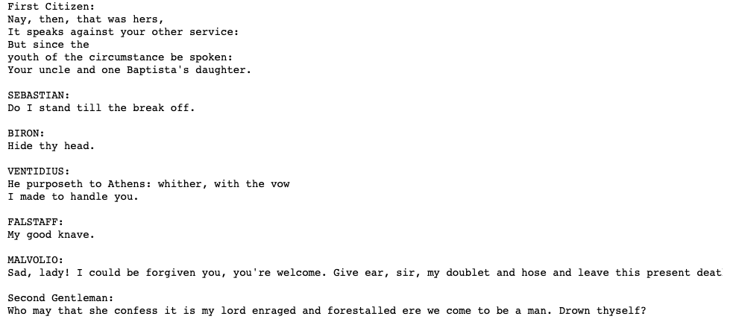
Result from 10-letter model
Notes:
20 letter model
Begin?

Slide 15
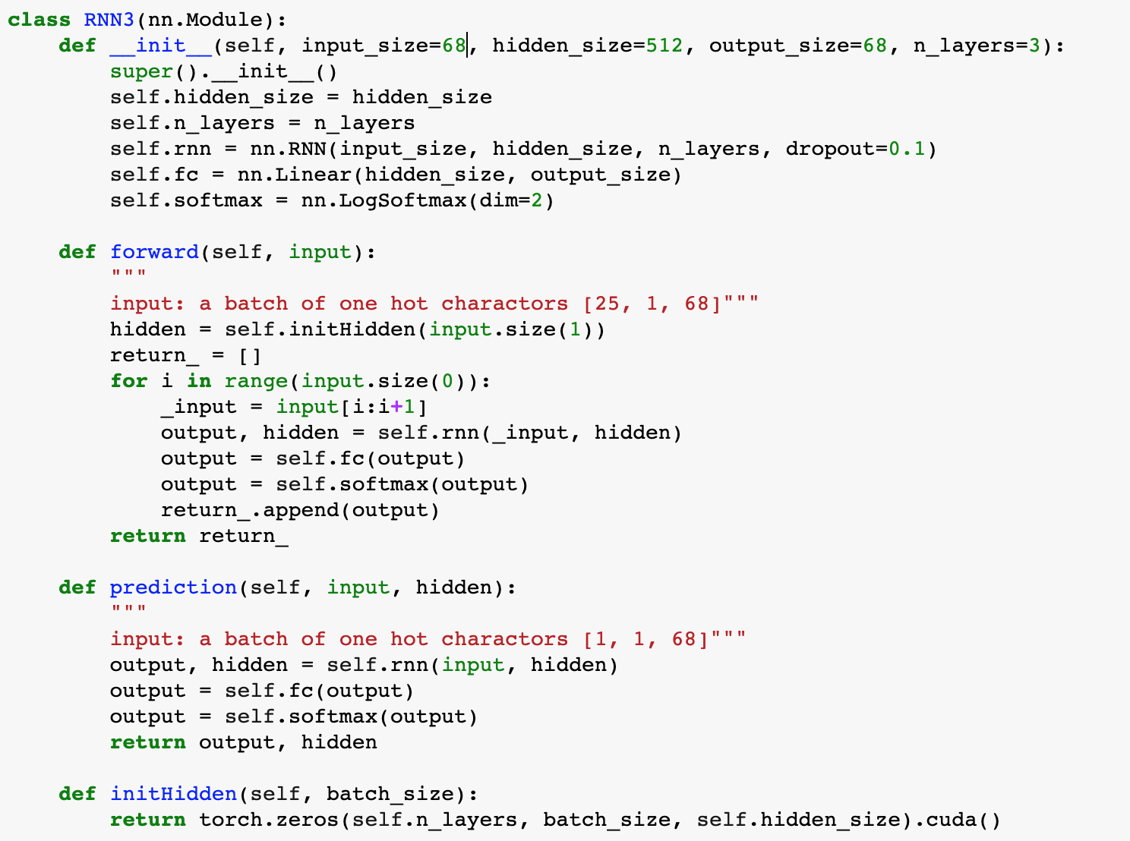
Three layers RNN model
This is a 3-layer RNN with 512 hidden nodes on each layer.
We have
1. 68 x 516 + 516
2. 516 x 516 + 516
3. 516 x 516 + 516
4. 516 x 516 + 516
5. 516 x 68 + 68
6. 68
871,146 parameters in total
N_para x 4 bytes = 3.48 MB
Backward pass ~ 11 MB
Notes:
Context sensitive

Slide 16
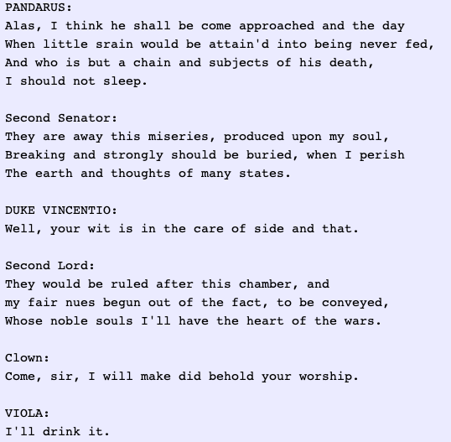
Three layers RNN model

Slide 17
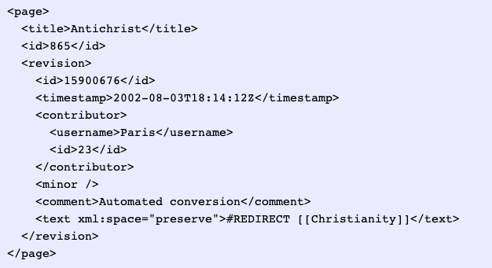
For xml format (multi-layer LSTM)

Slide 18
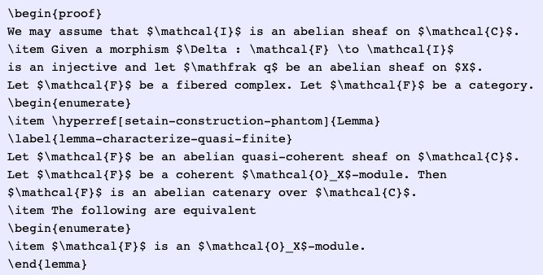
Even Latex (multi-layer LSTM)

Slide 19
Thanks
References
https://pytorch.org/tutorials/
https://nbviewer.jupyter.org/gist/yoavg/d76121dfde2618422139
https://karpathy.github.io/2015/05/21/rnn-effectiveness/
https://cs.stanford.edu/people/karpathy/char-rnn/shakespear.txt
https://gist.github.com/karpathy/d4dee566867f8291f086
Code on github
https://github.com/bobaoai/Sample_RNN.git

Slide 20
Place Holder
(show the results of the simple RNN Model)
PANDARUS: Alas, I think he shall be come approached and the day When little srain would be attain'd into being never fed, And who is but a chain and subjects of his death, I should not sleep.
Second Senator: They are away this miseries, produced upon my soul, Breaking and strongly should be buried, when I perish The earth and thoughts of many states.
DUKE VINCENTIO: Well, your wit is in the care of side and that.
Second Lord: They would be ruled after this chamber, and my fair nues begun out of the fact, to be conveyed, Whose noble souls I'll have the heart of the wars.
Clown: Come, sir, I will make did behold your worship.
VIOLA: I'll drink it.

Slide 21
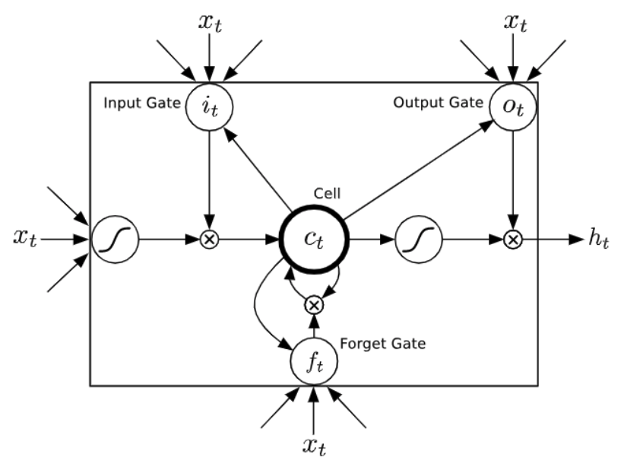
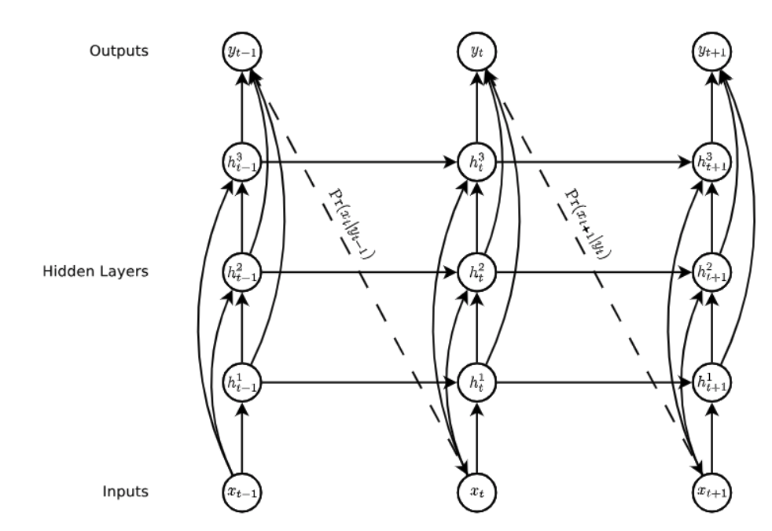
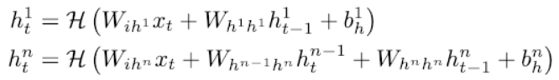
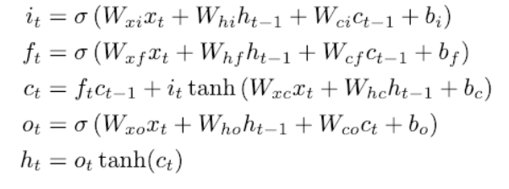
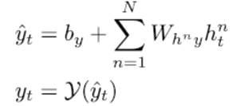
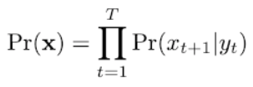
LSTM Model for letter-level prediction
Notes:
https://arxiv.org/pdf/1308.0850.pdf
the network is ‘deep’ in both space
and time, in the sense that every piece of information passing either vertically
or horizontally through the computation graph will be acted on by multiple
successive weight matrices and nonlinearities.
Note the ‘skip connections’ from the inputs to all hidden layers, and from
all hidden layers to the outputs. These make it easier to train deep networks,
by reducing the number of processing steps between the bottom of the network
and the top, and thereby mitigating the ‘vanishing gradient’ problem [1]. In
the special case that
N
= 1 the architecture reduces to an ordinary, single layer
next step prediction RNN

Slide 22
Penn Treebank Experiments
Training 930,000 words
Validation 74,000 words
Test 82,000 words
Vocabulary 10,000 words
Architecture a single layer with 1000 LSTM units
Letter-level input and output layers are 49 4.3 million weights in total.
Words-level input and output are 10,000 words, and 54 million weights in total.
Notes:
All networks
were trained with stochastic gradient descent, using a learn rate of 0.0001 and a
momentum of 0.99. The LSTM derivates were clipped in the range [−1,1]

Slide 23
Model evaluation and regularization(Want to add more resources for this topic)
Neural networks are usually evaluated on test data with fixed weights. For prediction problems however, where the inputs are the targets, it is legitimate to allow the network to adapt its weights as it is being evaluated (so long as it only sees the test data once). Mikolov refers to this as dynamic evaluation. Dynamic evaluation allows for a fairer comparison with compression algorithms, for which there is no division between training and test sets, as all data is only predicted once.

Slide 24


LSTM Model Introduction

Slide 25


1. forget gate / input gate
Notes:
https://colah.github.io/posts/2015-08-Understanding-LSTMs/
Let’s go back to our example of a language model trying to predict the next word based on all the previous ones. In such a problem, the cell state might include the gender of the present subject, so that the correct pronouns can be used. When we see a new subject, we want to forget the gender of the old subject.

Slide 26

Memory update
Notes:
https://colah.github.io/posts/2015-08-Understanding-LSTMs/

Slide 27

3. Output Gate
Notes:
https://colah.github.io/posts/2015-08-Understanding-LSTMs/

Slide 28
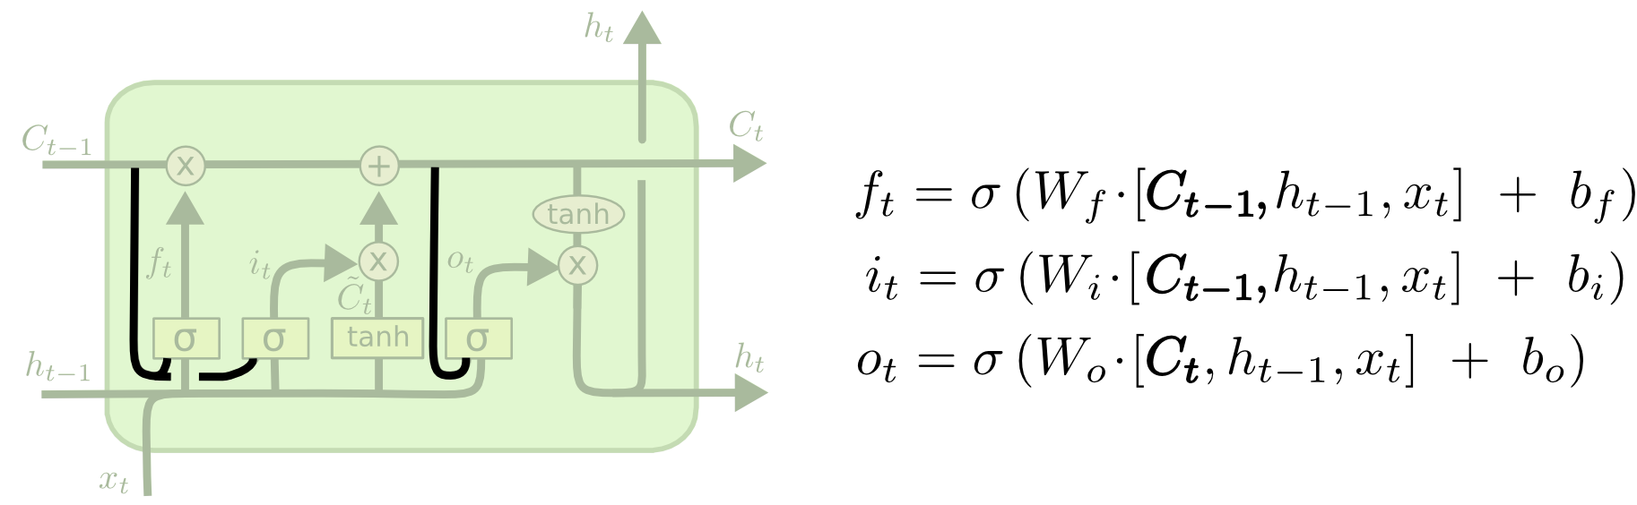
Will add more architectures for LSTM and RNN
A overview of structure and application?
Notes:
https://colah.github.io/posts/2015-08-Understanding-LSTMs/

